Slide 1

Coursera Capstone project
By Yuqian, July 2020

Slide 2
Problems to be solved
How to find an apartment in Manhattan with the following conditions:
• Apartment with min 2 bedrooms
• Monthly rent not to exceed US$7000/month
• Located within walking distance (<=1.0 mile, 1.6 km) from a subway metro station in Manhattan
• Venues and amenities as in my current residence.

Slide 3
Data acquisition and cleaning
Singapore data and map is to be created with use of Nominatim, Foursquare and Folium mapping.
Manhattan neighbourhoods were obtained from Wikipedia and organized by Neighbourhoods with geodata via Nominatim for mapping with Folium.
List of Subway stations was obtained via Wikipedia, NY Transit web site and Google map.
List of apartments for rent was consolidated from web-scraping real estate sites for MH. The geolocation (lat,long) data was found with algorithm coding and using Nominatim.
Folium map was the basis of mapping with various features to consolidate all data in ONE map where one can visualize all details needed to make a selection of apartment

Slide 4
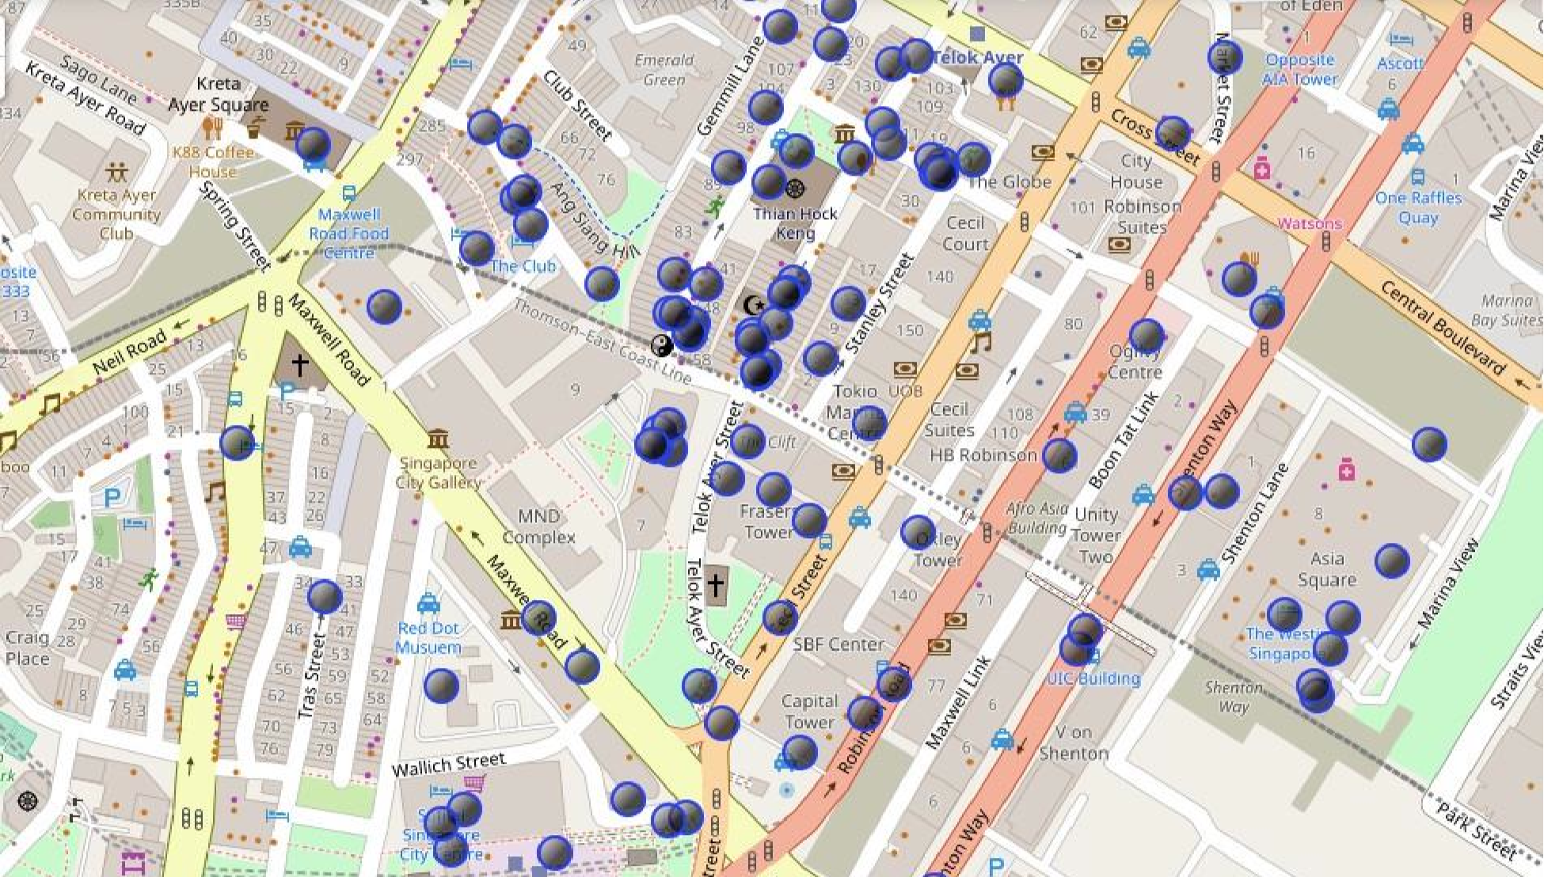
Current residence Neighborhood in Singapore

Slide 5
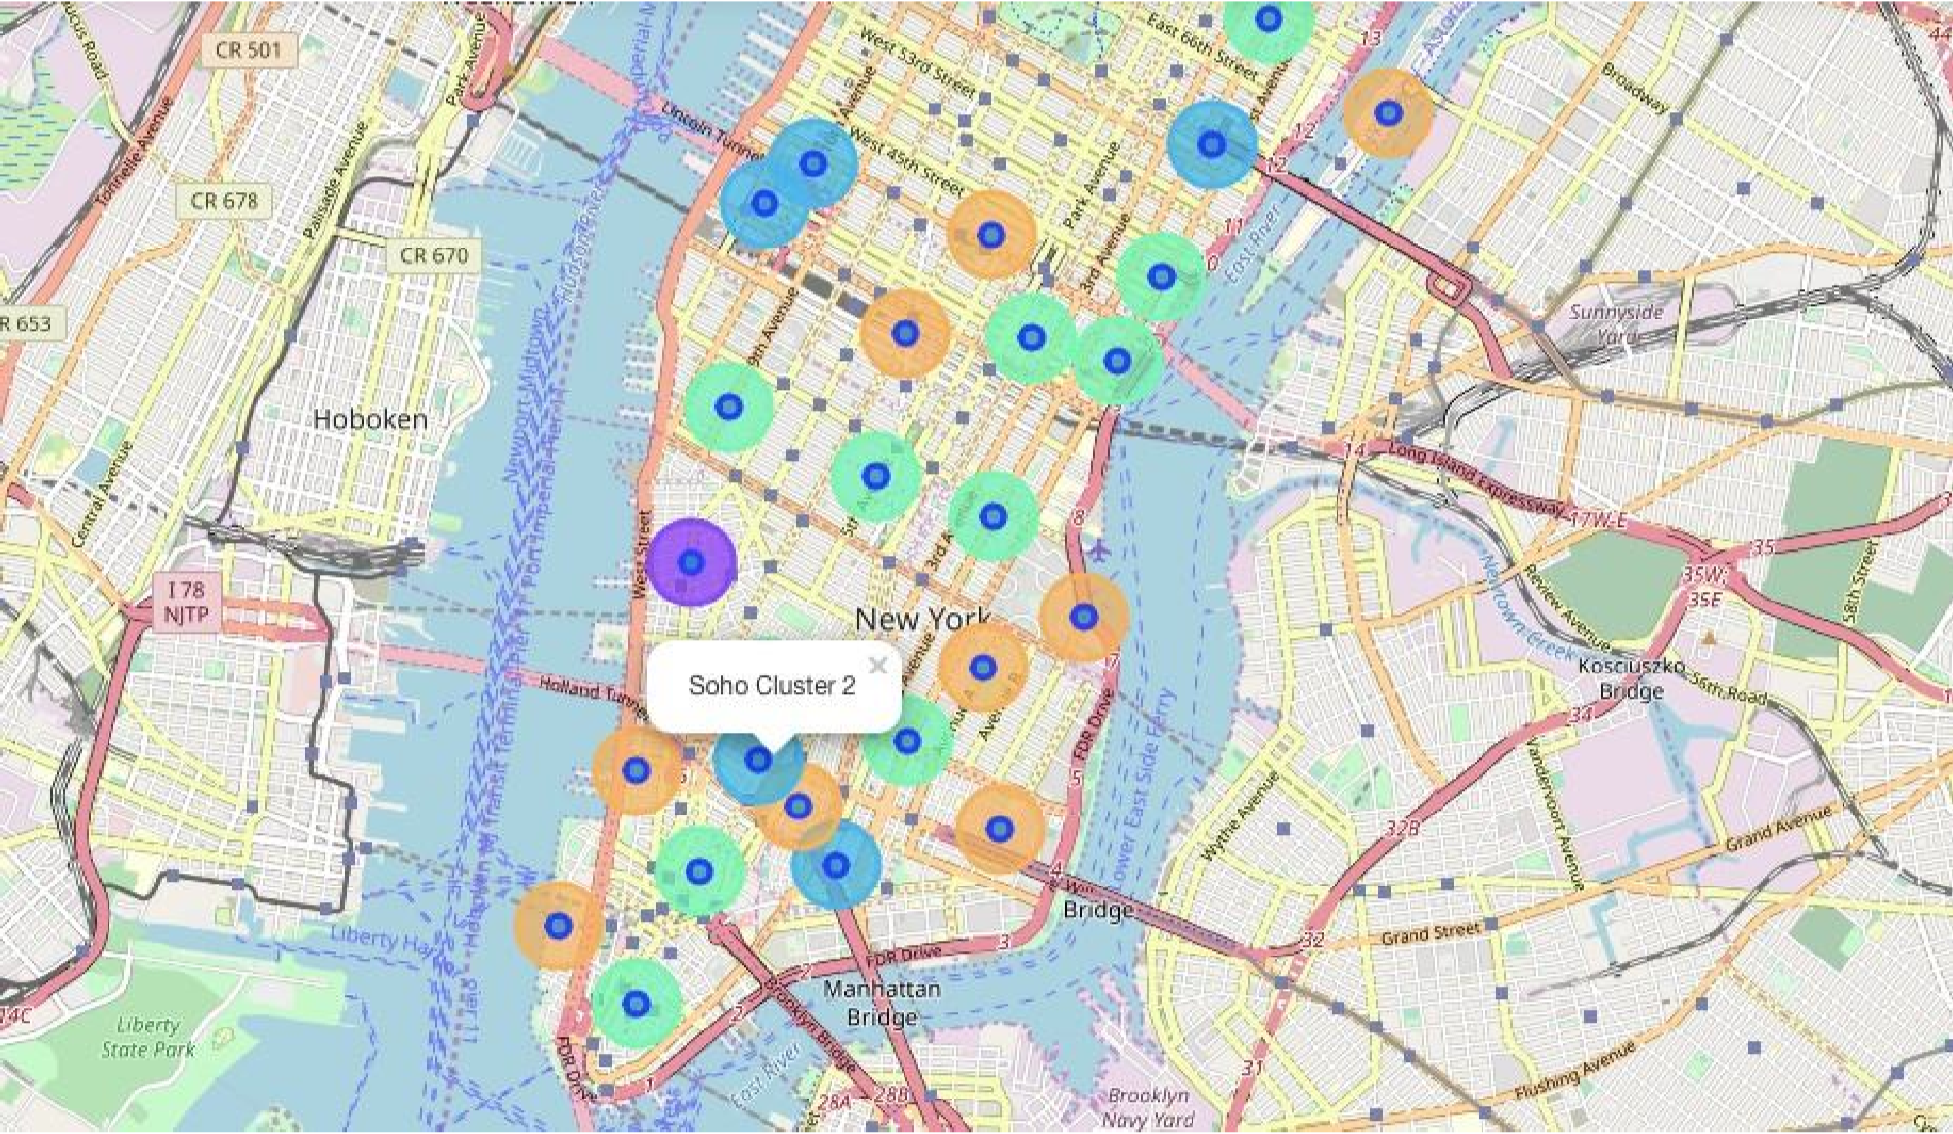
Neighborhoods and Cluster of Venues in Manhattan

Slide 6
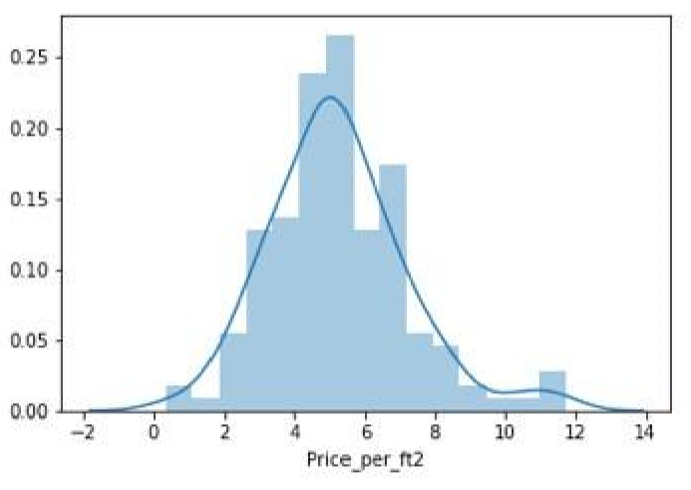
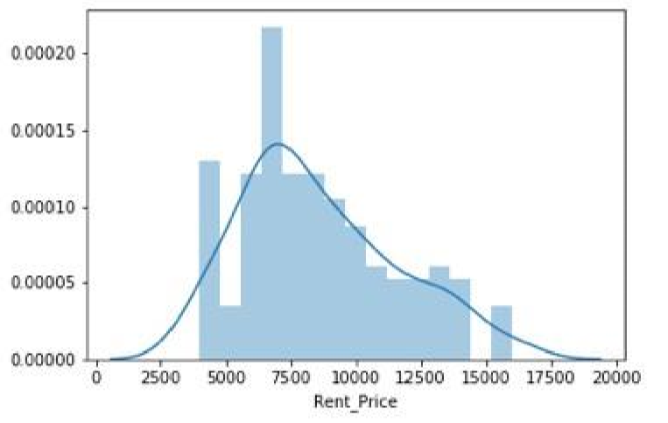
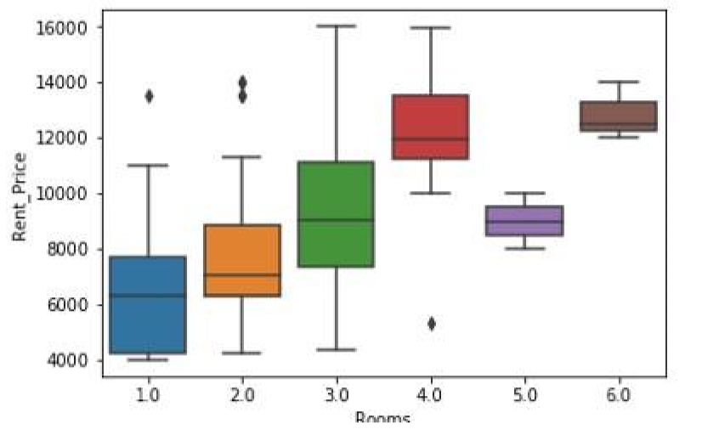
Rental Price Statistics MH Apartments

Slide 7
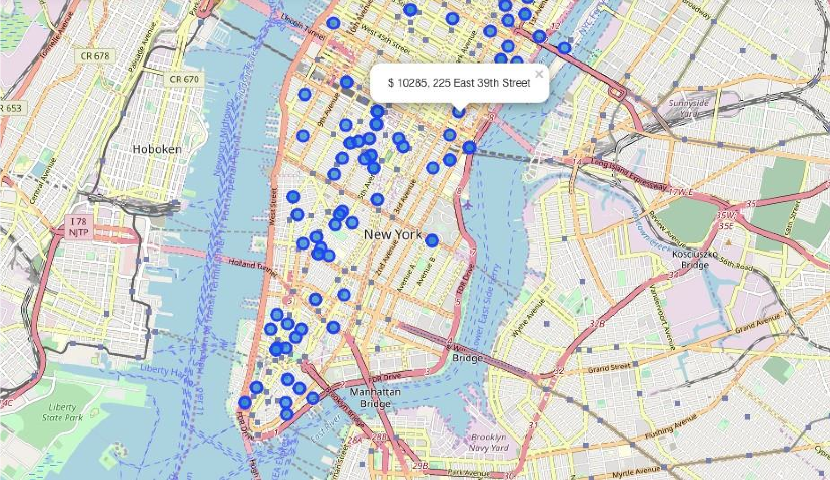
Apartments for Rent in MH

Slide 8
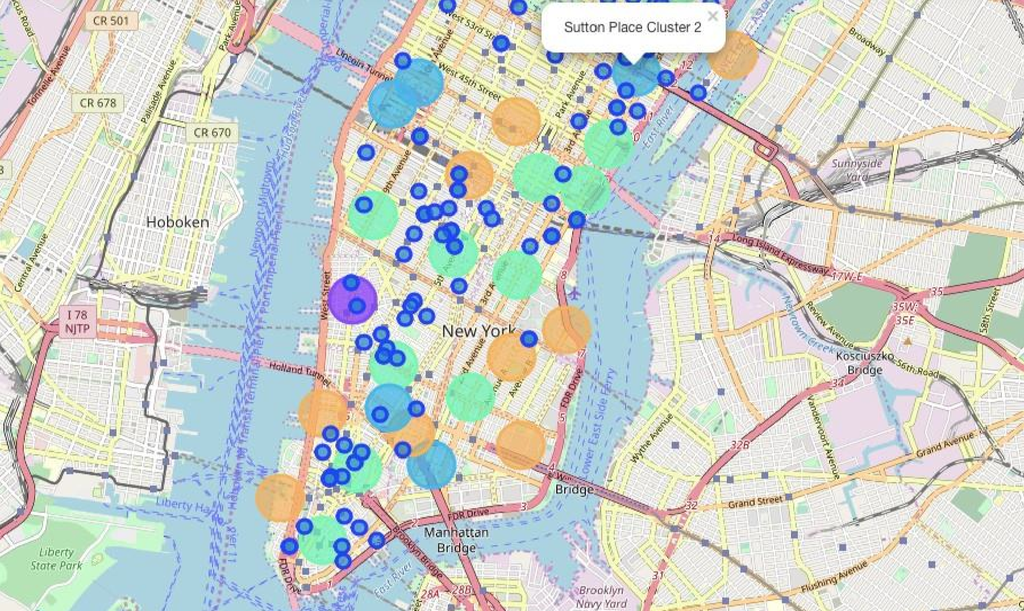
Venue clusters

Slide 9
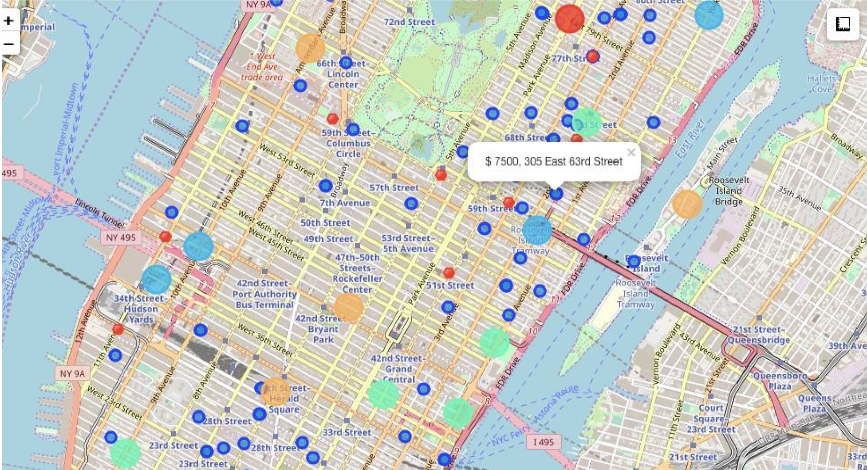
Selected Apartment
Shows all information:
Apartments address
Price
Neighbourhood
Cluster of venues
Subway stations
Blue dots=apts
Red dots=Subway station
Bubbles=Cluster of Venues

Slide 10
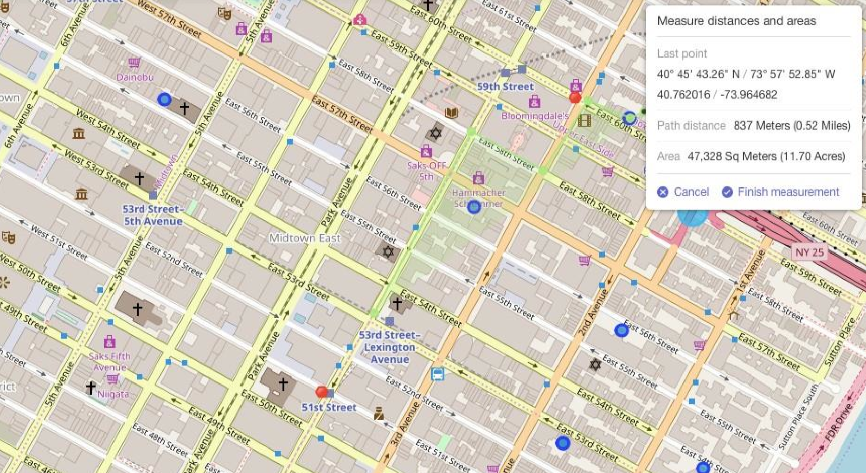
Final Decision
Thank you for listening!

